Slide 1
SDLC-Software Development Life Cycle Models
By
Dr. Junaid Akram
Assistant Professor, Department of Computer Science COMSATS (Lahore)

Slide 2
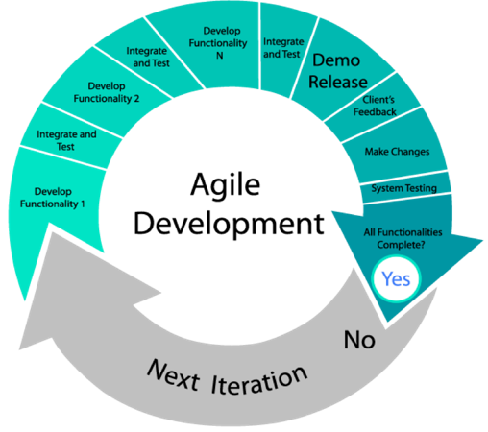
SDLC - Agile Model
Every iteration involves cross functional teams working simultaneously on various areas like −
Planning
Requirements Analysis
Design
Coding
Unit Testing and
Acceptance Testing.
At the end of the iteration, a working product is displayed to the customer and important stakeholders.

Slide 3
Agile Model - Advantages
Is a very realistic approach to software development.
Promotes teamwork and cross training.
Functionality can be developed rapidly and demonstrated.
Resource requirements are minimum.
Suitable for fixed or changing requirements
Delivers early partial working solutions.
Good model for environments that change steadily.
Minimal rules, documentation easily employed.
Enables concurrent development and delivery within an overall planned context.
Little or no planning required.
Easy to manage.
Gives flexibility to developers.

Slide 4
Agile Model - Disadvantages
Not suitable for handling complex dependencies.
More risk of sustainability, maintainability and extensibility.
An overall plan, an agile leader and agile PM practice is a must without which it will not work.
Strict delivery management dictates the scope, functionality to be delivered, and adjustments to meet the deadlines.
Depends heavily on customer interaction, so if customer is not clear, team can be driven in the wrong direction.
There is a very high individual dependency, since there is minimum documentation generated.
Transfer of technology to new team members may be quite challenging due to lack of documentation.

Slide 5
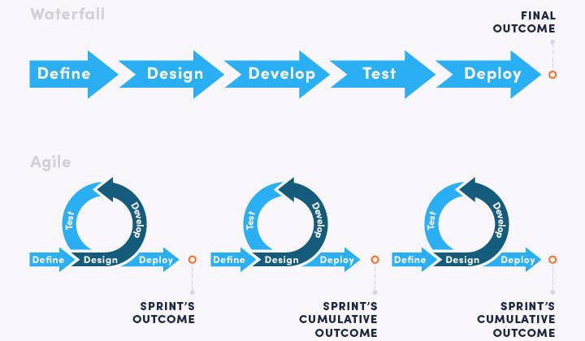
Agile vs. Waterfall: Quick Comparison

Slide 6
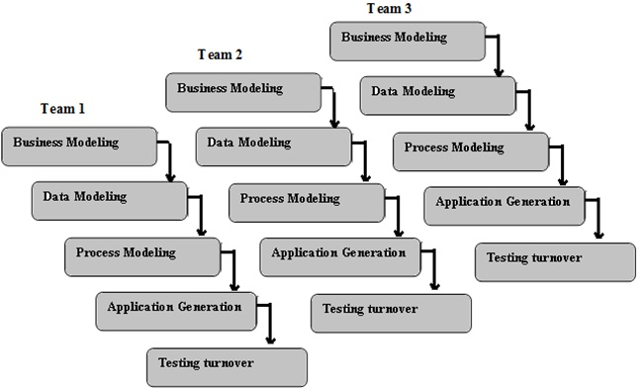
SDLC - RAD Model (Rapid Application Development)

Slide 7
RAD Model Design
Following are the various phases..
Business Modelling
The business model for the product under development is designed in terms of flow of information and the distribution of information between various business channels. A complete business analysis is performed to find the vital information for business, how it can be obtained
Data Modelling
The attributes of all data sets is identified and defined. The relation between these data objects are established and defined in detail in relevance to the business model.
Process Modelling
The data object sets defined in the Data Modelling phase are converted to establish the business information flow needed to achieve specific business objectives as per the business model. Process descriptions for adding, deleting, retrieving or modifying a data object are given.
Application Generation
The actual system is built and coding is done by using automation tools to convert process and data models into actual prototypes.
Testing and Turnover
The overall testing time is reduced in the RAD model as the prototypes are independently tested during every iteration

Slide 8
RAD Model - Advantages
Changing requirements can be accommodated.
Progress can be measured.
Iteration time can be short with use of powerful RAD tools.
Productivity with fewer people in a short time.
Reduced development time.
Increases reusability of components.
Quick initial reviews occur.
Encourages customer feedback.
Integration from very beginning solves a lot of integration issues.

Slide 9
RAD Model - Disadvantages
Only system that can be modularized can be built using RAD.
Requires highly skilled developers/designers.
High dependency on Modelling skills.
Inapplicable to cheaper projects as cost of Modelling and automated code generation is very high.
Management complexity is more.
Suitable for systems that are component based and scalable.
Requires user involvement throughout the life cycle.
Suitable for project requiring shorter development times.

Slide 10
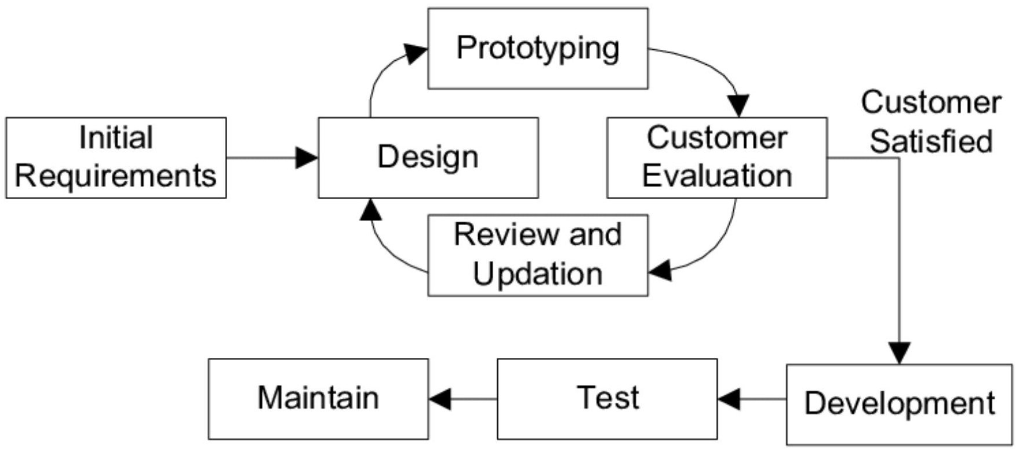
SDLC - Software Prototype Model
Basic Requirement Identification
Developing the initial Prototype
Review of the Prototype
Revise and Enhance the Prototype

Slide 11
Prototype Model - Advantages
Increased user involvement in the product even before its implementation.
Since a working model of the system is displayed, the users get a better understanding of the system being developed.
Reduces time and cost as the defects can be detected much earlier.
Quicker user feedback is available leading to better solutions.
Missing functionality can be identified easily.
Confusing or difficult functions can be identified.

Slide 12
Prototype Model - Disadvantages
Risk of insufficient requirement analysis owing to too much dependency on the prototype.
Users may get confused in the prototypes and actual systems.
Practically, this methodology may increase the complexity of the system as scope of the system may expand beyond original plans.
Developers may try to reuse the existing prototypes to build the actual system, even when it is not technically feasible.
The effort invested in building prototypes may be too much if it is not monitored properly.

Slide 13
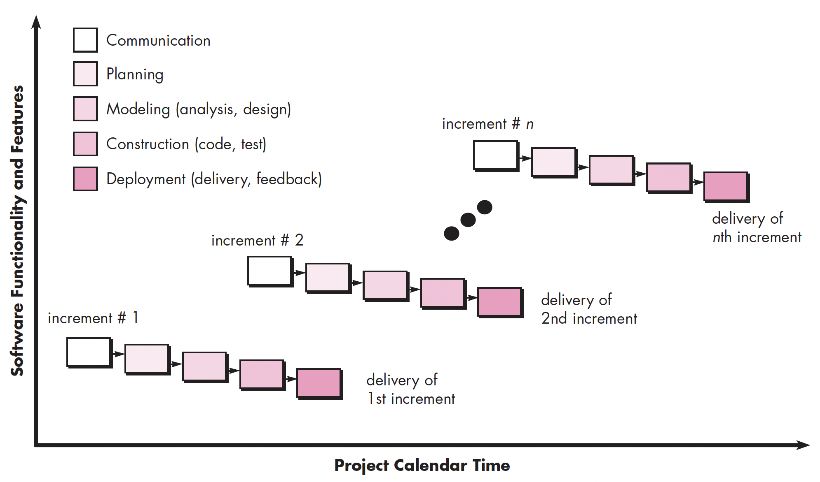
The Incremental Model
* The incremental process model focuses on the delivery of an operational product with each increment

Slide 14
Other Process Models
Component based development— the process to apply when reuse is a development objective
Formal methods— emphasizes the mathematical specification of requirements
Aspect-oriented software development— provides a process and methodological approach for defining, specifying, designing, and constructing aspects
Unified process— a “use-case driven, architecture-centric, iterative and incremental” software process closely aligned with the Unified Modeling Language (UML)

Slide 15

Thanks for your attention!
Any Question?
Email me on : junaidakram@cuilahore.edu.pk

